Slide 1
From Chaos to Catalogue–Getting Items into your Library
By: Shari Jadoolal
Notes:
A guide to efficient research management

Slide 2
Housekeeping
This session is being recorded. If you do not want to be recorded, please keep your camera off.
Please use the raised hand function if you have a question or to answer.
For troubleshooting issues please contact ebabirye@ualberta.ca

Slide 3
Today's Session
We will cover:
Adding items via web browser extensions
Importing PDFs
Manually entering data
Importing from Other Reference Managers

Slide 4
ADDING ITEMS & FILES
Notes:
(e.g., books, journal articles, web pages, etc.)

Slide 5
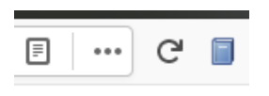
Web Browser
Main page for a journal article, the save button will change to the icon of a journal article
On a library catalogue for a book, the icon will be a book

Slide 6
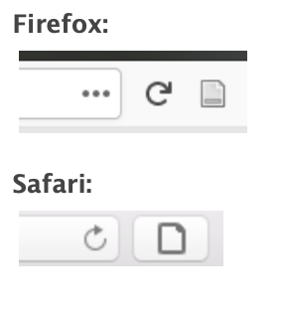
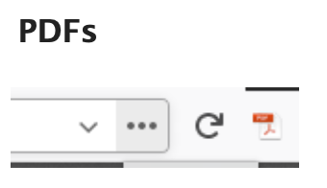
Generic Web Pages
If Zotero can’t recognize a webpage, the save button turns gray and imports the page as a “Web Page” items with its title, URL and access date.
When viewing a PDF, saves as a PDF icon, imports the file attempting to retrieve metadata. For better results save from the publications abstract or catalogue.

Slide 7
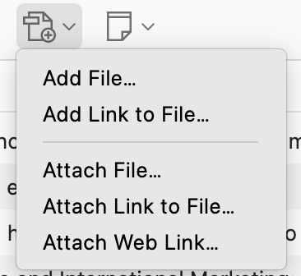
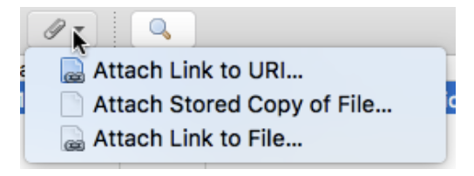
Adding Files
Drag & Drop
Drop files onto a collection or empty space → Standalone item
Drop onto an existing item → Child attachment
New Item Button
Store Copy of File… → Saves a file copy
Link to File… → Creates a file link
Attachment Menu
Attach Stored Copy or Attach Link → Add files to items
Attach Link to URI… → Add web links (e.g., OneNote, Evernote)

Slide 8
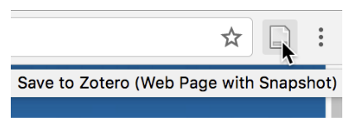
Snap Shot
Zotero can save a webpage as a snapshot, capturing its state at that time.
If no data is recognized, click the Zotero save button to save it as a Web Page item with a snapshot.
Snapshots are saved by default but can be disabled in preferences.

Slide 9
IMPORTING PDFs

Slide 10
Tutorial
Saving to a specific collection
U of A library search & Google Scholar
Drag & Drop
Snapshot
How to import PDFs
Notes:
Most efficient way to get PDFs into Zotero is to use U of A library search. Click PDF full text, then press the Zotero button. This will let the PDF go directly into Zotero with no issue
If there is no PDF file then use Google Scholar to download
Purpose is to have Zotero PDF files as the primary, if that is not possible then links and screenshots are secondary

Slide 11
MANUALLY ENTERING DATA

Slide 12
Tutorial
Add missing information
Retrieve Metadata

Slide 13
IMPORTING FROM OTHER REFERENCE MANAGERS

Slide 14
Mendeley
To import your Mendeley library, follow these steps:
Make sure that all data and files have been synced to Mendeley servers.
If you use Mendeley Reference Manager, your data and files are already all online.
If you use Mendeley Desktop, check your sync settings to make sure that data and files are being synced, and confirm that you can open PDFs in your online Mendeley library.
Make sure you're running the latest version of Zotero (Help → Check for Updates…).
Go to File → Import within Zotero and choose the “Mendeley Reference Manager (online import)” option.
Notes:
Zotero can directly import all data, including the full folder structure, from an online Mendeley library.

Slide 15
EndNote (export)
Exporting EndNote Library to Zotero
Export Library as XML
EndNote can’t import directly into Zotero. Export your library in XML format.
Convert Figures to Attachments (For older libraries)
Go to References → Figure → Convert Figures to File Attachments.
Select References (Optional)
Choose specific references to export, or leave all selected.
Choose EndNote Data Directory
Save the export file in the EndNote data directory, not subfolders.
Save as XML
Select XML as the file format and click Save.
Close EndNote
Complete the export and exit EndNote.

Slide 16
EndNote (import)
Importing EndNote Library into Zotero
Backup Your Zotero Data
Before importing, create a backup of your Zotero data directory in case you need to restore it later.
Disable Auto-Sync Temporarily
Turn off auto-sync in Zotero's Sync preferences to prevent unwanted changes.
Import Your EndNote Library
Go to File → Import, select your exported .xml file (from My Documents\endnote.Data), and click Open.
Handling Unsupported Fields
Zotero will add unsupported EndNote fields as notes (e.g., author info). These notes are tagged "_EndnoteXML import."
Review & Delete Notes
Check if any data should be retained or moved to Zotero fields. Delete unnecessary notes to avoid performance issues.
Quickly Delete Notes
Use the tag filter “_EndnoteXML import” to select and delete all related notes at once.

Slide 17
Covidence
Import from Zotero to Covidence***pdfs must be in Zotero***
To bulk upload missing full text PDFs from Zotero to Covidence
On Covidence go to “Full Text Review”
Click “Bulk Upload Missing Full Text”
Download studies missing PDFs by clicking “Download Studies”
Find missing pdfs using Zotero (in depth explanation to finding PDFs in Zotero)
Drag and drop EndNote XML file
Upload PDF file
Full text should now be available in “Full Text Review”

Slide 18
For more information
Visit Zotero for more information regarding instructions for other popular reference management tools: https://www.zotero.org/support/moving_to_zotero

Slide 19
QUESTIONS?

Slide 20
Upcoming Events
ANNOUNCEMENTS:
This presentation will be emailed
Lookout for the PRAN Newsletter on March 13th: New section called “What's in Zotero”
Visit the PRAN Website for more information regarding Zotero
March 19th @ 12:00 MT: Master Your Library–Organizing & Taking Notes
March 12th @ 12:00 MT: SSAI Census Data Lunch & Learn (more details to come)
Notes:
Ekb announcement for next feature
Slides on how to join the PRAN library
Whats new in zotero on the website

Slide 21
How to join the PRAN Library
Please provide your email address associated to your Zotero account. Click here to join now!
You can also sign up using the upcoming Zotero registration form for Master your library–organizing & taking notes

