Slide 1
Zotero 101—Your Research Superpower
By: Shari Jadoolal

Slide 2
What is your experience with referencing?
Have you used a reference management software before? If yes, which one?

Slide 3
Getting Started

Slide 4
Installation
You can download Zotero on the Zotero download page. Be sure to also install the Zotero Connector for your browser.
Mac: Open the .dmg you downloaded and drag Zotero to the Applications folder. You can then run Zotero from Spotlight, Launchpad, or the Applications folder and add it to your Dock like any other program.
After installing Zotero, you can eject and delete the .dmg file.
Windows: Run the setup program you downloaded.

Slide 5
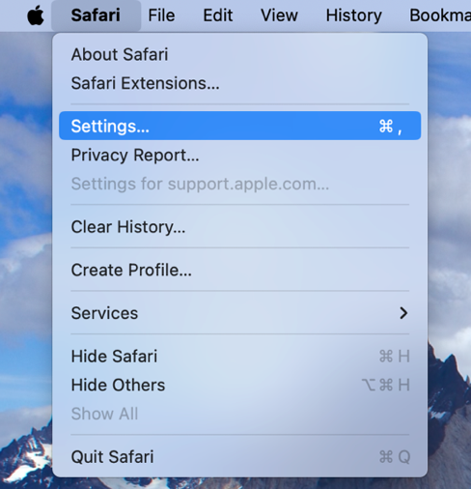
For Mac Users
To enable Zotero for Safari it needs to be enabled from the Extensions pane in Safari settings
Open Safari
From Safari click Settings
Select the Extensions tab
Check the box next to Zotero extension to enable it

Slide 6
About Zotero

Slide 7
Zotero
Easy to use tool to help you collect, organize, annotate, cite and share research. Available on web browser or for desktop.
The purpose of integrating Zotero is to help streamline research in one tool!

Slide 8
Collect Items with a Click

Slide 9
Via Web Browser
The Zotero Connector save button is the most convenient and reliable way to add items with high-quality bibliographic metadata to your Zotero library.
As you browse the web, the Zotero Connector will automatically find bibliographic information on web pages you visit and allow you to add it to Zotero with a single click.
Book
PDF
Journal Article
Notes:
https://www.zotero.org/support/adding_items_to_Zotero
To use Zotero properly, you need to install the Zotero Connector for Chrome, Firefox, Edge, or Safari, in addition to the Zotero desktop app.
The Zotero Connector's save button is the most convenient and reliable way to add items with high-quality bibliographic metadata to your Zotero library. As you browse the web, the Zotero Connector will automatically find bibliographic information on webpages you visit and allow you to add it to Zotero with a single click.
For example, if you're on the main page for a journal article, the save button will change to the icon of a journal article (circled in red):

Slide 10
Manually Add or Use Identifier
To manually add
Download the document. Drag and drop the file into your library or collection
Using identifier
Add items to your library if you already know their ISBN, DOI, PubMed, arXiv, or ADS Bibcode
Click add item using the identifier button in the tool bar, insert identifier code and press enter

Slide 11
Personal Organization
Notes:
Zotero helps you organize your research any way you want. You can sort items into collections and tag them with keywords. Or create saved searches that automatically fill with relevant materials as you work.

Slide 12
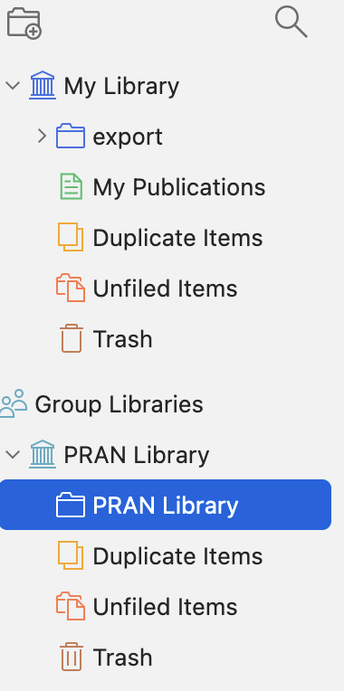
Organize your research any way you want
Create collections within your library
Tag items with key words. Tags allow you filter and sort through your Zotero library
Create saved searches that automatically fill with relevant materials as you work
New Collection

Slide 13
Generate Citations & Bibliographies: Google Docs vs Word
Notes:
Zotero must be connected to the Zotero desktop application in order to use the web based citing.
Please ensure file is saved as a google doc and not microsoft word.docx to enable Zotero integration
Choose file→ Save as Google Doc to enable this functionality
The first time you do this you’ll need to link your Zotero account with your google drive account
Zotero instantly creates references and bibliographies for any text editor, and directly inside Word, LibreOffice, and Google Docs

Slide 14
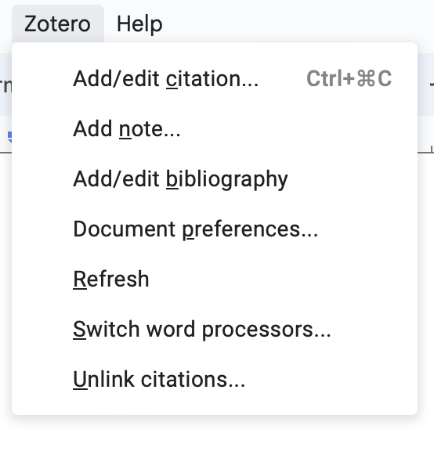
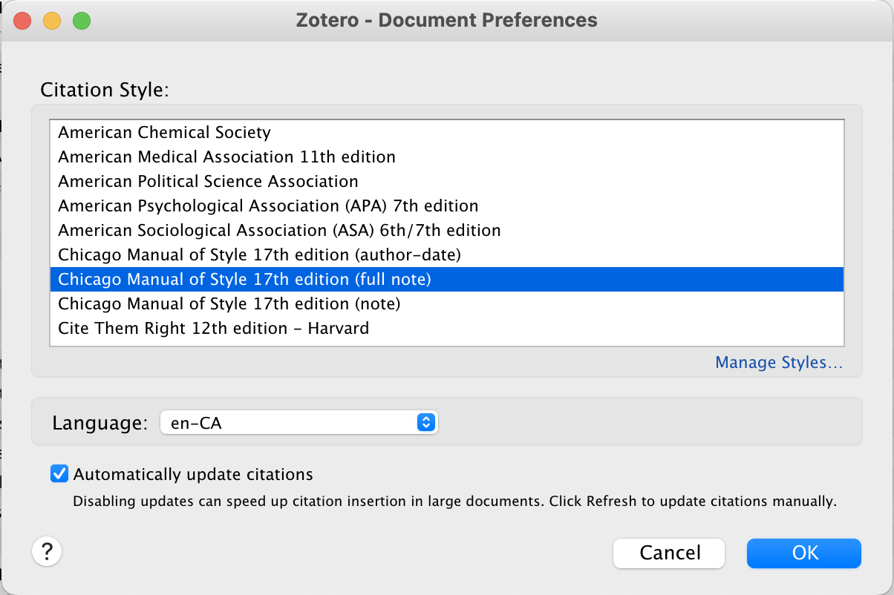
Google Docs
Step 1
Step 2
Easiest Way
Step 3
Notes:
The drop down menu allows you to add citations, bibliography and change the citation format of your document
To add a citation, place your cursor at the end of the sentence where you want to add a citation. There are 2 ways to insert a citation:
Click the Z icon on the toolbar
Click on the Zotero menu and click add/edit citation
In the pop-up window that appears, you can choose your preferred citation style, then click ok
In the red box that comes up, type in part of the title or an author for the paper you want to cite. Select the correct paper from the dropdown menu.
The citation is now where your cursor was placed
To change the citation style, click on the Zotero menu, then document preferences. Click on the new preferred style and press ok.

Slide 15
Bibliography
To create a bibliography, click on the Zotero menu and then add/edit bibliography. A bibliography, formatted in your chosen citation style will be added to your paper.

Slide 16
Microsoft Word
Step 1
Once installed, Zotero can be found in the toolbar. Click the tab to add/edit citations and bibliography.

Slide 17
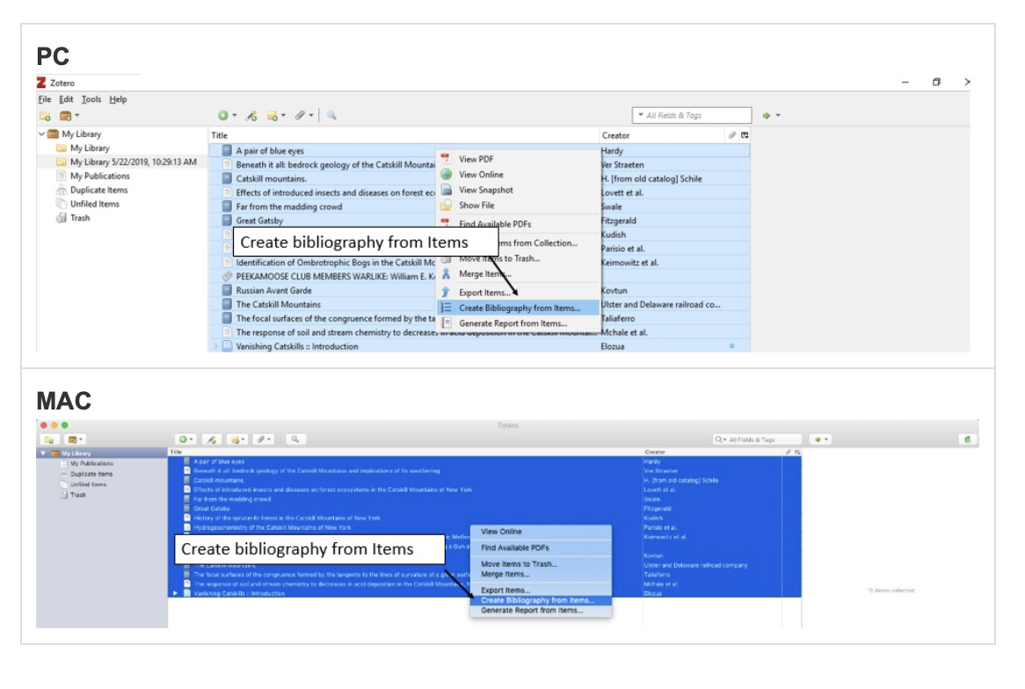
Stand Alone Bibliography
Select some or all of the references in your Zotero library. Right click and select Create Bibliography from Items.

Slide 18
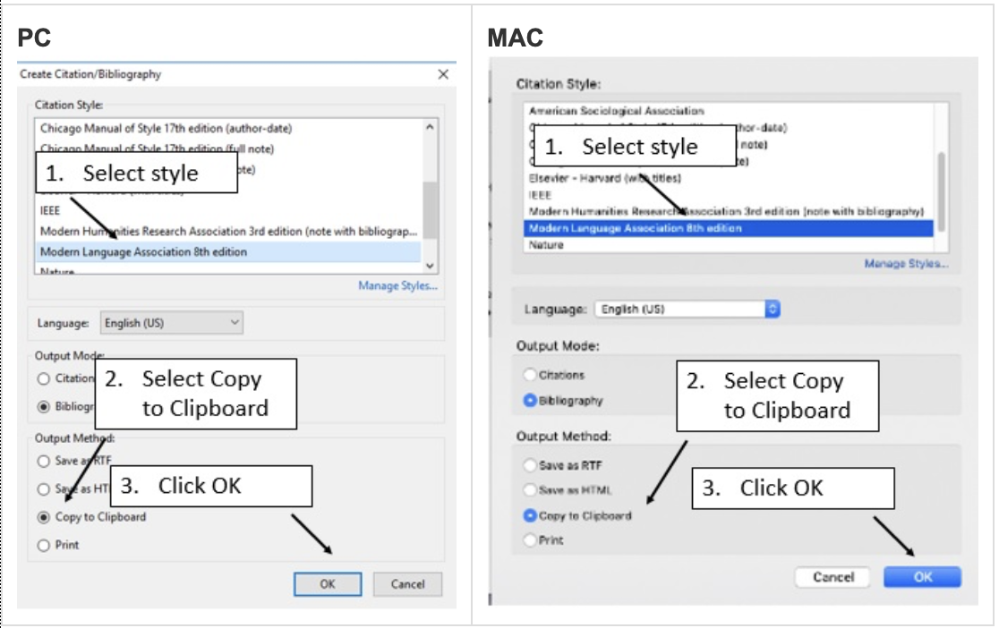
Stand Alone Bibliography
Choose citation style and copy to clipboard for pasting into document or email

Slide 19
Stay in Sync
Zotero can optionally synchronize your data across devices, keeping your files, notes and bibliographic records seamlessly up to date.

Slide 20
Easy Collaboration
Zotero lets you collaborate freely from co-writing papers with colleagues to, distributing course materials to students or building a collaborative bibliography. You can share a Zotero with as many people as you desire.

Slide 21
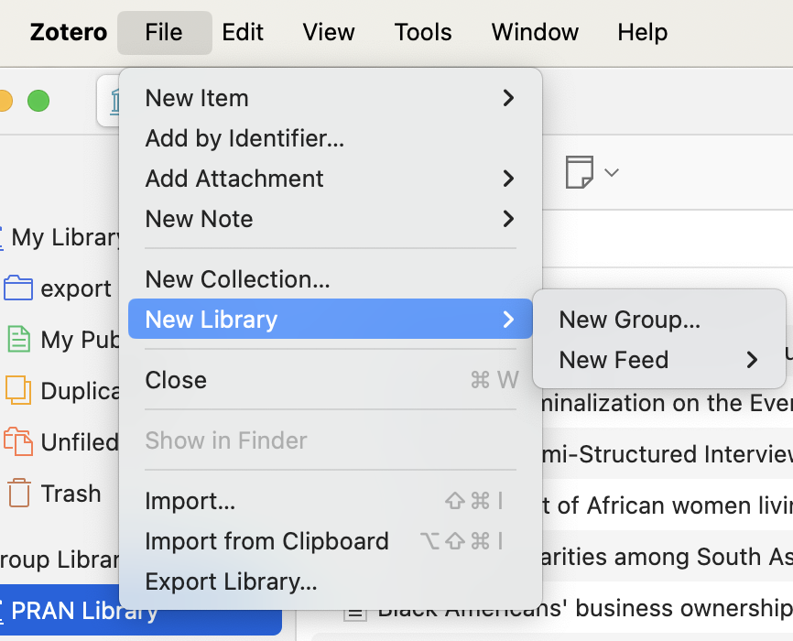
Creating Group Libraries
Group libraries are separate from your personal “My Library”, so you can use Zotero groups as a way to keep separate libraries within one Zotero profile
2 ways to create Zotero Groups
File → New Library → “New Group”
Click “Create a New group” Button on Zotero.com

Slide 22
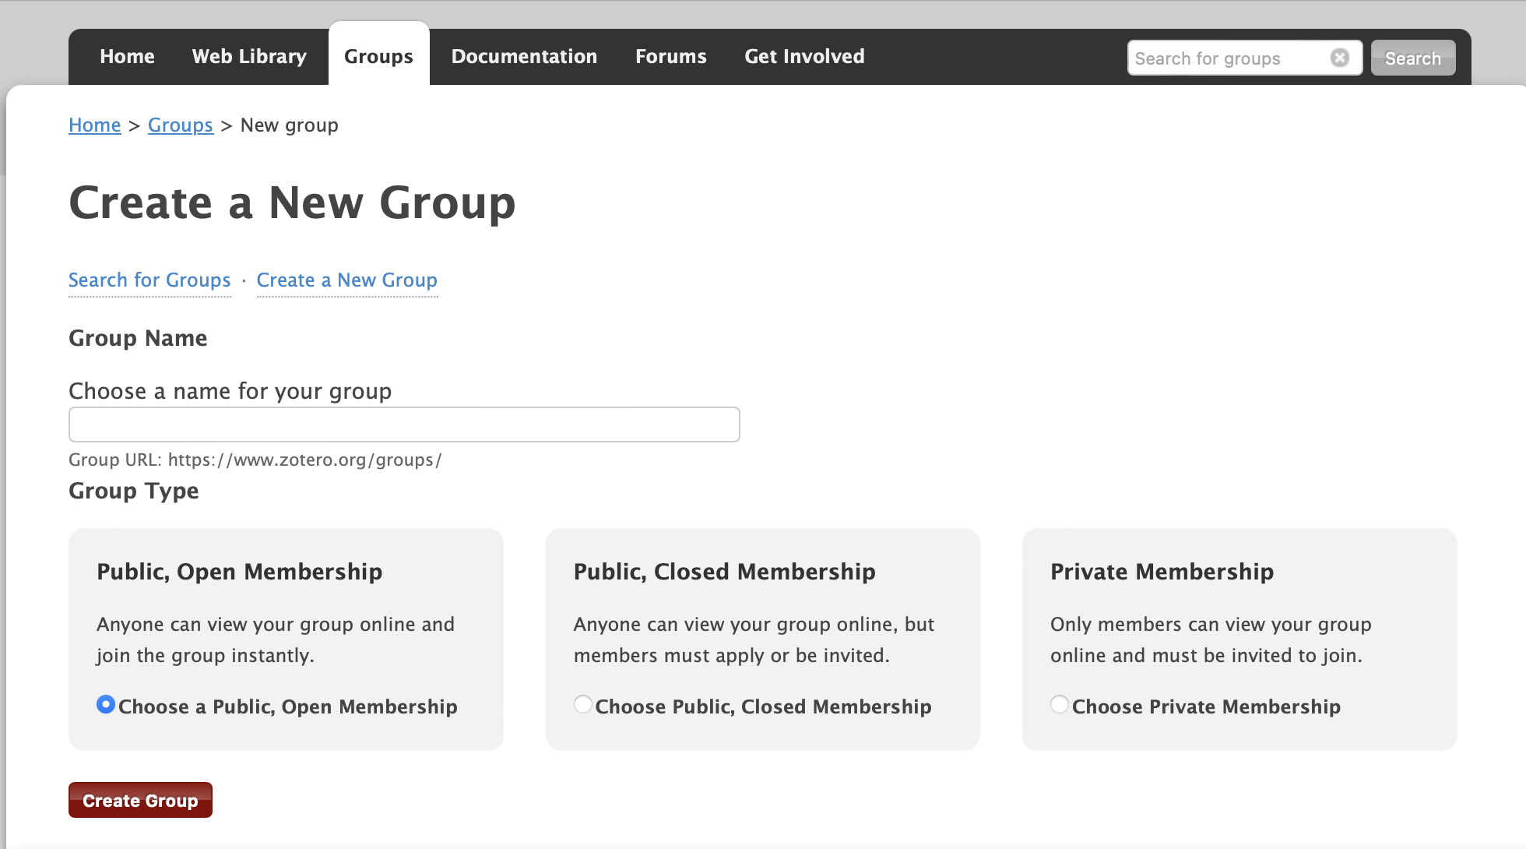
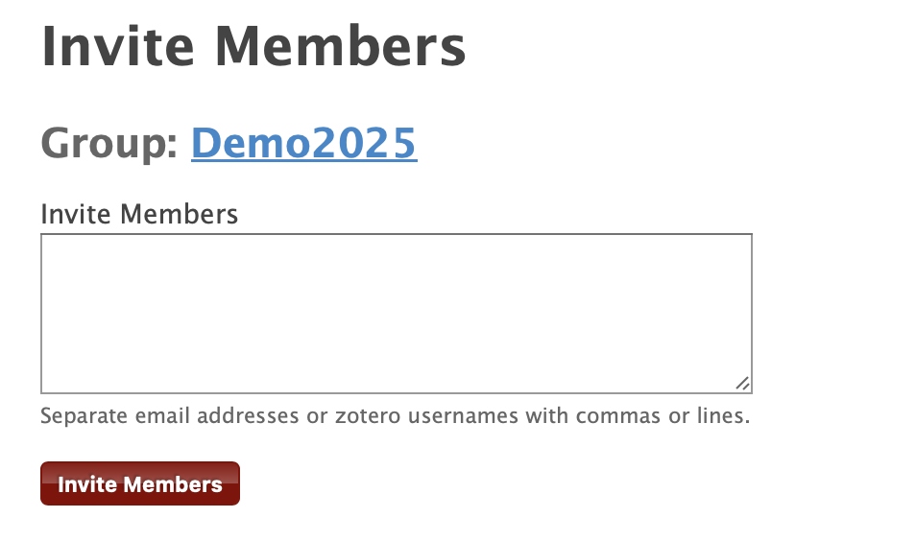
Continued
Notes:
Choose: public closed membership
Refer to the Zotero tip sheet for more in depth information pertaining to membership types
Yoou have to manually update Zotero. Help check for updates on mac to update Zotero

Slide 23
Keeping Zotero Up to Date
Have the latest version of Zotero by checking for updates in the help menu bar.
Notes:
With mac at least, you have to manually check for updates, update the software. If you encounter issues then close the app, relaunch it, and try updating it again.

Slide 24
Questions?

Slide 25
Webinar Sessions & Dates
From Chaos to Catalog—Getting Items into your library February 19th 2025
Master Your Library—Organizing and Taking Notes March 19th 2025
Cite Like a Pro—Bibliographies, Citations & Reports April 23rd 2025
Collaborate Smarter—Syncing, Sharing & Backup May 21st 2025
Go Beyond Basics—Getting the Best from Zotero June 25th 2025

